Slide 1
ASSOCIATION OF AMERICAN GEOGRAPHERS
GIS SPECIALTY GROUP
2015 BUSINESS MEETING AGENDA
Wednesday, 4/22/2015
7:15 PM - 8:15 PM
Columbus H, Hyatt, East Tower, Gold Level
Approval of the 2014 minutes
2015 AAG GIS Specialty Group Events
2015 Distinguished career award recipient
Student awards (Somi Dodge)
Election nomination review & voting (Dan Goldberg)
Budget report (Xinuye Ye)
GIS Specialty Group website updates (Dan Goldberg)
Incoming chair’s report (Diansheng Guo)
Other announcements

Slide 2
GIS Specialty Group Events Weds-Friday
2717 Geographic Information Science and Systems Specialty Group Business Meeting
Wednesday, 4/22/2015, from 7:15 PM - 8:15 PM in Columbus H, Hyatt, East Tower, Gold Level
3548 CyberGIS Symposium: Transactions In GIS Plenary
Thursday, 4/23/2015, from 3:20 PM - 5:00 PM in Crystal A, Hyatt, West Tower, Green Level
3648 The Waldo Tobler Distinguished Lecture in GIScience
Thursday, 4/23/2015, from 5:20 PM - 7:00 PM in Crystal A, Hyatt, West Tower, Green Level
GISS Specialty Group Reception
Thursday, 4/23/2015, from 7:30 PM - 9:30 PM in Crystal A, Hyatt, West Tower, Green Level
4467 GIS Specialty Group Honors Student Paper Competition
Friday, 4/24/2015, from 1:20 PM - 3:00 PM in Michigan C, Hyatt, East Tower, Ped Path

Slide 3
GIS Specialty Group Awards
The Waldo Tobler Distinguished Lecture in GIScience:
Professor Elizabeth Wentz, Arizona State University
Robert T. Aangeenbrug Distinguished Career Award:
Professor Timothy Nyerges, University of Washington

Slide 4
GIS Specialty Group Personnel Updates
Incoming Chair
Diansheng Guo
Associate Professor,
University of South Carolina
Incoming Treasurer/Secretary
Xinyue Ye
Assistant Professor
Kent State University
Somayeh Dodge
Assistant Professor of GIScience
Department of Geography & Environmental Studies, University of Colorado
Outgoing Chair
Daniel Goldberg
Assistant Professor of Geography,
Texas A&M University
Outgoing Academic Councilor

Slide 5

Incoming Chair
Dr. Diansheng Guo is an Associate Professor of Geography at the University of South Carolina
His research interests include GIScience, information visualization, spatial data mining and knowledge discovery, spatial optimization, and their applications in various geographic domains.
He is currently on the editorial board for Transactions in GIS, Professional Geographer, and Cartography and Geographical Information Science.

Slide 6
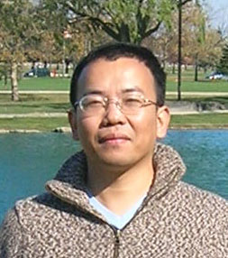
Incoming Treasurer/Secretary
Xinyue Ye is an Assistant Professor of Geography and Director of Computational Social Science Lab at Kent State University
He is a geographic information scientist and human geographer, with expertise in space-time analytics and open source toolbox development.
In his research, he integrates quantitative and
qualitative methods in interdisciplinary setting,
exploring inequality issues across scales and in various geographical settings.

Slide 7
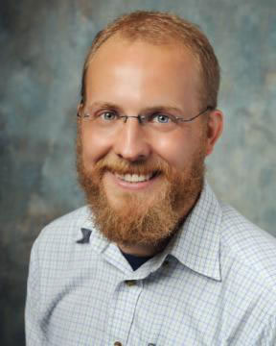
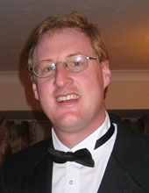
GIS Specialty Group Election Updates
Nominees for Vice Chair
Zachary Christman
Assistant Professor
Rowan University
christmanz@rowan.edu
Fresh faced geographer/remote senser and fellow beard owner.
Andrew Klein,
Professor
Texas A&M University
klein@tamu.edu
13 years of experience as GIS educator and researcher. Academic Chair of the TAMU GeoSAT Center. Been to Antarctica more times than would like to count.

Slide 8
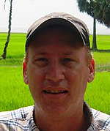
GIS Specialty Group Election Updates
Nominees for Academic Director
Thomas (Tom) Crawford,
Professor and Banpu Chair
Center for Sustainability
Saint Louis University
crawfordtw@slu.edu
Currently finishing two year role as secretary/treasurer for the
COMA spec group (coastal/marine). In this role, he has organized the COMA
student paper competitions [three sessions
and 13 competitors, this year alone]

Slide 9
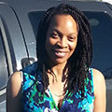
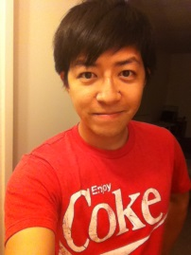
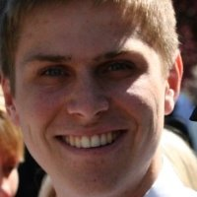

GIS Specialty Group Election Updates
Nominees for Student Director
Crystal English, PhD Student
San Diego State University
cenglish@rohan.sdsu.edu
Currently finishing first terms as GISS-SG Student Director.
Jiue-An (Jay) Yang, PhD Student
San Diego State University
jyang@mail.sdsu.edu
Many time student paper competition finalist
Nate Gill, PhD Student
Clark University
ngill82@gmail.com
Eager student, looking to contribute
Panshu Zhao, PhD Student
Texas A&M University
rochesterzhao@tamu.edu
Senior PhD student looking to make a contribution

Slide 10
Student Awards

Slide 11
Budget Report

Slide 12
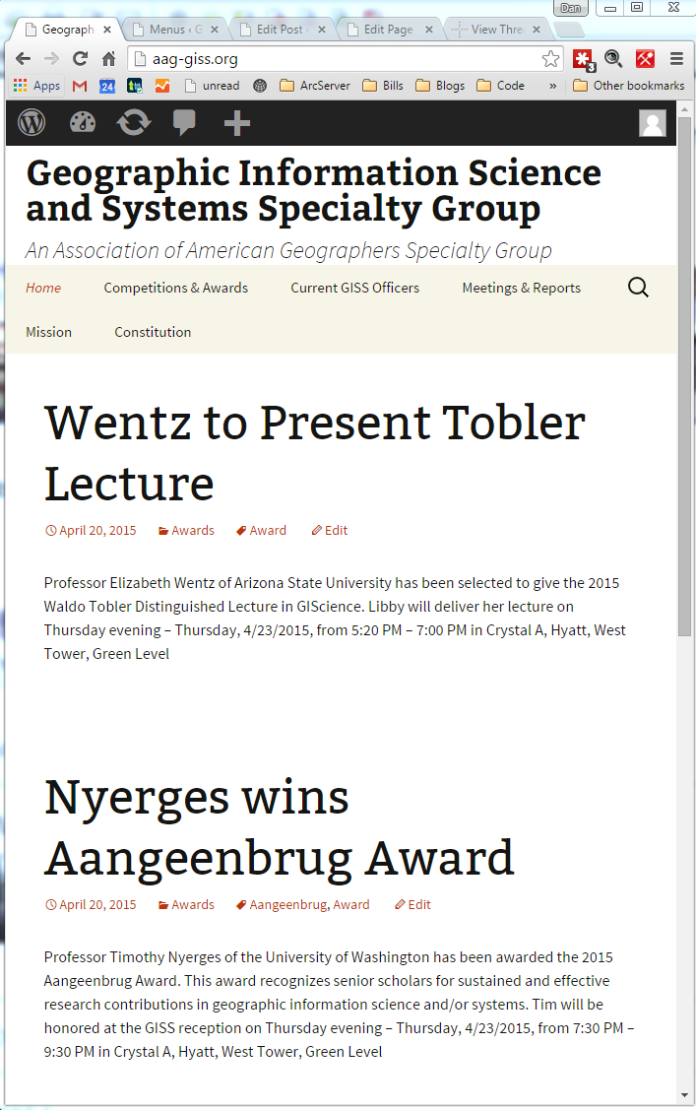
Updated Website
Old: http://geography.sdsu.edu/aaggis/
New: http://aag-giss.org/
Wordpress
  Multiple user admin
  Blog-based
Domain Registration
  $13.95/yr
  Expires 6/24/2019
Site hosting
  Dreamhost - $23.40/year
  Unlimited disk space

Slide 13
Incoming Chair’s Report
Increase communications and interactions among members to build community;
(2) Provide enhanced benefits and services to members;
(3) Consider adding an award to recognize new research breakthrough in GIScience to promote GISSG

